Slide 1

An Exploration of Data Science in the Federal Register
Joel Nantais – DATA 601

Slide 2

Project Overview
My project uses a REST API to access the Federal Register containing Federal Register Notices and Regulatory Rules since 1994 to find instances where federal agencies have posted publications which involve data science techniques.

Slide 3

Introduction to the APA
The Administrative Procedures Act (APA) of 1946:
to require agencies to keep the public informed of their organization, procedures and rules;
to provide for public participation in the rulemaking process, for instance through public commenting;
to establish uniform standards for the conduct of formal rulemaking and adjudication; and
to define the scope of judicial review

Slide 4

Data Set Methods
Using Python requests, I connected to the Federal Register REST API.
My get request payload pulled columns of:
Document Identification Numbers
Title
Agency Name
Publication Dates
Type of Document (i.e., Notice, Rule) and subtype
Topic Tags
Abstracts
I also used different search terms to pull the above columns for document which contained any of the following:
Artificial Intelligence, Big Data, Business Intelligence, Data Analytics, Data Mining, Data Science, and Machine Learning

Slide 5
Data Set Summary
The Dataset created contains 758 federal register documents, 638 are unique.
The earliest document has a publication date of February 17, 1994 and the latest was published on November 12, 2019 (the data was pulled on November 12, 2019).
There are 48 unique agencies represented.
Between 1994 and November 12, 2019, there have been 819,160 documents published in the federal register.
The proportion of documents containing a data science search term is 0.00078 percent, very small!

Slide 6
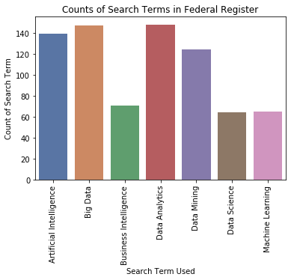

Slide 7
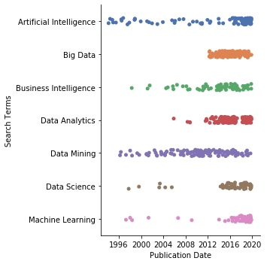
Use of Data Science Terms over Time

Slide 8
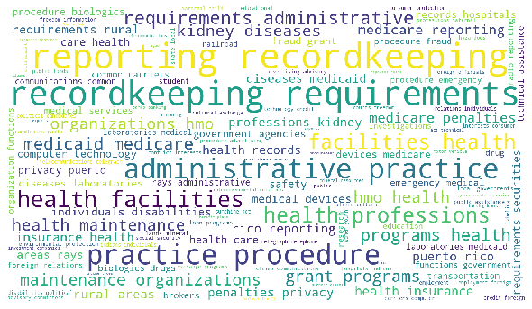
ALL AGENCY - TOPICS WORDCLOUD

Slide 9
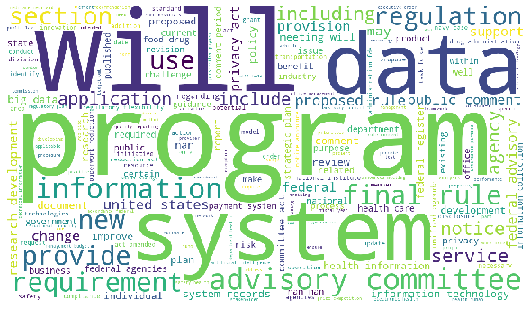
ALL AGENCY - ABSTRACT WORDCLOUD

Slide 10
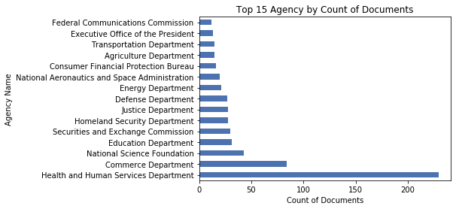

Slide 11
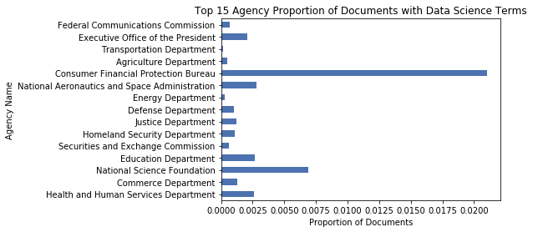

Slide 12

HHS in More Detail

Slide 13
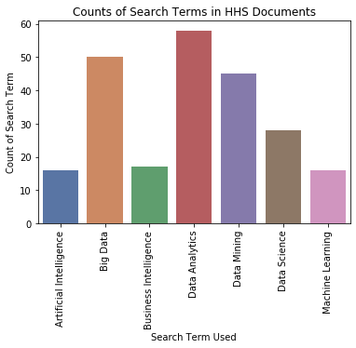

Slide 14
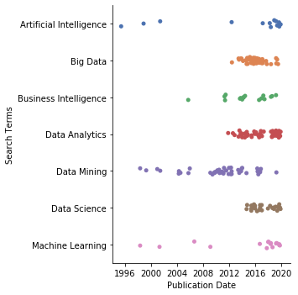

Slide 15
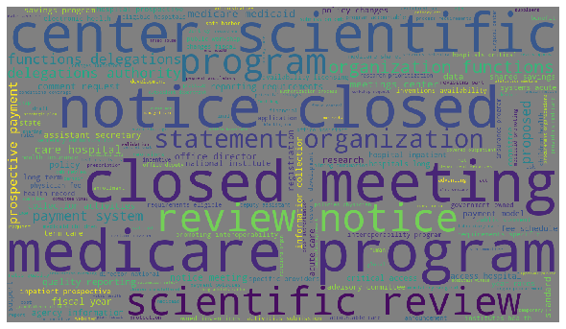
HHS - TITLE WORDCLOUD

Slide 16
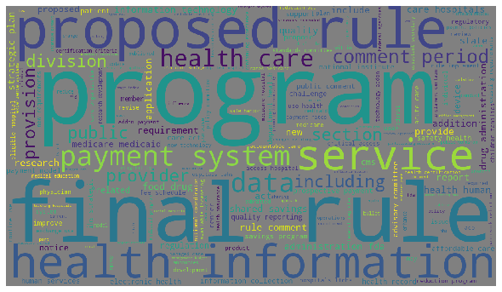
HHS – ABSTRACT WORDCLOUD

Slide 17
HHS Document Titles…when the search term is in the abstract “Data Science”
Using Informatics To Improve Data Analysis of Chemical Screening Assays Conducted in Zebrafish; Notice of Webinars; Registration Information
Announcement of Requirements and Registration for the Open Science Prize

Slide 18
HHS Document Titles…when the search term is in the abstract “Big Data”
Advancing the Development of Pediatric Therapeutics: Application of “Big Data” to Pediatric Safety Studies; Public Workshop
Advancing the Development of Biomarkers in Traumatic Brain Injury; Public Workshop; Request for Comments
Health IT Policy Committee and Health IT Standards Committee; Call for Applications
Advisory Council on Alzheimer's Research, Care, and Services; Meeting

Slide 19
HHS Document Titles…when the search term is in the abstract “Data Mining”
State Medicaid Fraud Control Units; Data Mining
This final rule amends a provision in HHS regulations prohibiting State Medicaid Fraud Control Units (MFCU) from using Federal matching funds to identify fraud through screening and analyzing State Medicaid data, known as data mining. To support and modernize MFCU efforts to effectively pursue Medicaid provider fraud, we finalize proposals to permit Federal financial participation (FFP) in costs of defined data mining activities under specified circumstances. In addition, we finalize requirements that MFCUs annually report costs and results of approved data mining activities to OIG.

Slide 20

The APA doesn’t require everything to be posted in the Federal Register
I was not able to pull down the entire text of documents (limited text analysis)
Snowball sampling method may be more effective
Search Terms were arbitrary, could have done a cluster or factor analysis

Slide 21

Thank you.
This Photo by Unknown Author is licensed under CC BY

